Slide 1
How to build run charts, check sheets and a pareto graph

Slide 2
Pareto Analysis
Data types
Variable and attribute
Run Charts

Slide 3
Variable data
Data that is measured & plotted
  e.g. temperature, cost, time, etc.
Averages can be calculated from this type of data to draw conclusions
Tools used to depict variable data:
  Run charts
  Scatter plots
Notes:
Minimum 5% of the population for data, 3 months, 3 weeks

Slide 4
Run Charts
Purpose: to study observed data in order to identify trends or patterns (if any) over a period of time
A graphical illustration to compare performance measures before and after implementation
of a business process improvement solution

Slide 5
Patterns of a Time Series (Run Chart)
Demand for snowboards
Year
1
Year
2
Year
3
Year
4
Notes:
Ask what do they see

Slide 6
Patterns of a Time Series (Run Chart)
Seasonal peaks (winters)
Trend component
Actual demand line
Demand for snowboards
Random variation
Year
1
Year
2
Year
3
Year
4

Slide 7
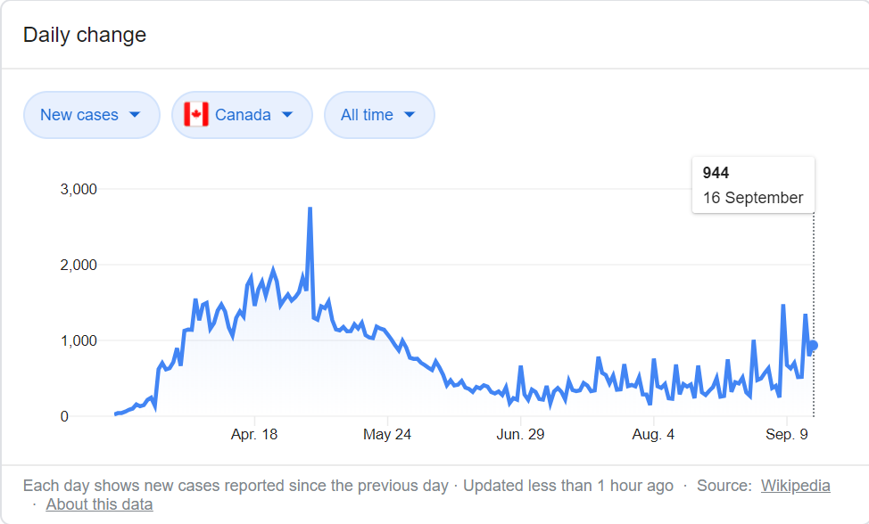
Run Chart Example:
Covid Stats - BC

Slide 8
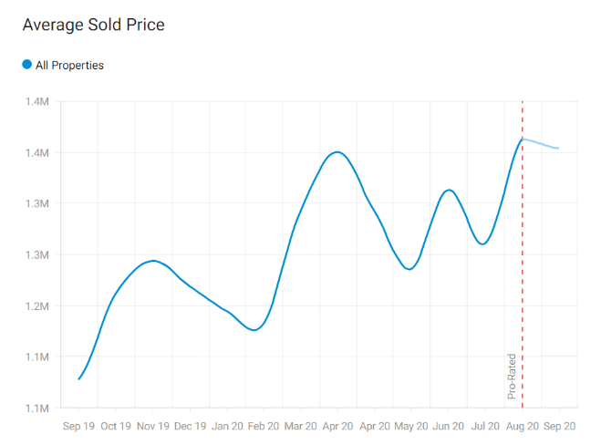
Run Chart Example:
Vancouver Housing (https://www.zolo.ca/vancouver-real-estate/trends)

Slide 9
Attribute data
Denotes quality of a product or service
Data that is counted & plotted
  e.g. types of shipping errors, reasons for down time.
Cannot calculate averages, however ‘counts’ can be plotted to draw conclusions
Tools used to depict attribute data:
  Check sheets
  Pareto charts

Slide 10
Check Sheets
Used:
  to record & compile data from historical sources or observations as they happen
  To clearly detect & display patterns/trends
Logical starting point for many data collection efforts

Slide 11
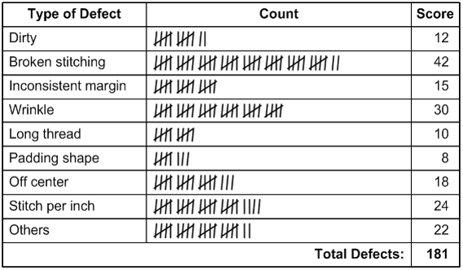
Check Sheet Example:

Slide 12

Pareto (80/20) Rule
Purpose
To focus on the problems that offer the greatest impact for improvement (i.e. key problems)
Highly visible illustration to incentivize for more improvement
The power of Pareto Charts lies in the Pareto Principle:
A small number of factors will typically control a given outcome the most
Identifying and focusing on these critical factors will maximize results, often times with far less effort than would be required if all factors were treated equally
Notes:
Vilfredo Pareto:
Italian engineer, sociologist, philosopher & economist
Observed that 80%of land in Italy was owned by 20% of people
Examples - application to business:
80% of income comes from 20% of clients
80% of costs come from 20% of suppliers
80% of complaints come from 20% of clients

Slide 13
Pareto Chart
Purpose:
  To focus on the problems that offer the greatest impact for improvement (i.e. key problems)
  Highly visible illustration to incentivize for more improvement
Elements arranged in order from highest frequency to lowest frequency
The power of Pareto Charts lies in the Pareto Principle:
  A small number of factors will typically control a given outcome the most.
  Identifying and focusing on these critical factors will maximize results, often times with far less effort than would be required if all factors were treated equally.

Slide 14
How to plot a Pareto chart?
Identify and list problems
Develop a standard measure for comparing
Sort the raw data from highest to the lowest
Perform cumulative calculations
Calculate percentage of raw data to total and raw data cumulative to cumulative total as well
Plot raw data on bar graph & a line graph of cumulative percentages.

Slide 15
Pareto Example : Warehouse Damages
Category | Damages ($)
BROKEN | 29,484
CRUSHED (EC) | 9,981
CUT / TORN (CP) | 24,235
DAMAGED LABEL (EE) | 1,032
LEAKY BOTTLE (LQ) | 561
PACKAGE OPENED (PC) | 671
SOILED (SL) | 1,123
Total | 67,087
Identify and list problems
Develop a standard measure for comparing

Slide 16
Pareto Example : Warehouse Damages
Category | Damages ($)
BROKEN | 29,484
CRUSHED (EC) | 24,235
CUT / TORN (CP) | 9,981
DAMAGED LABEL (EE) | 1,123
LEAKY BOTTLE (LQ) | 1,032
PACKAGE OPENED (PC) | 671
SOILED (SL) | 561
Total | 67,087
Sort the raw data from highest to the lowest

Slide 17
Pareto Example : Warehouse Damages
Category | Damages ($) | Cumulative ($)
BROKEN | 29,484 | 29,484
CRUSHED (EC) | 24,235 | 53,719
CUT / TORN (CP) | 9,981
DAMAGED LABEL (EE) | 1,123
LEAKY BOTTLE (LQ) | 1,032
PACKAGE OPENED (PC) | 671
SOILED (SL) | 561
Total | 67,087
Perform Cumulative Calculation

Slide 18
Pareto Example : Warehouse Damages
Category | Damages ($) | Cumulative ($)
BROKEN | 29,484 | 29,484
CRUSHED (EC) | 24,235 | 53,719
CUT / TORN (CP) | 9,981 | 63,700
DAMAGED LABEL (EE) | 1,123
LEAKY BOTTLE (LQ) | 1,032
PACKAGE OPENED (PC) | 671
SOILED (SL) | 561
Total | 67,087
Perform Cumulative Calculation

Slide 19
Pareto Example : Warehouse Damages
Category | Damages ($) | Cumulative ($)
BROKEN | 29,484 | 29,484
CRUSHED (EC) | 24,235 | 53,719
CUT / TORN (CP) | 10,981 | 63,700
DAMAGED LABEL (EE) | 1,123 | 64,823
LEAKY BOTTLE (LQ) | 1,032 | 65,855
PACKAGE OPENED (PC) | 671 | 66,526
SOILED (SL) | 561 | 67,087
Total | 67,087
Perform Cumulative Calculation

Slide 20
Pareto Example : Warehouse Damages
Category | Damages ($) | Cumulative ($) | %
BROKEN | 29,484 | 29,484 | 44%
CRUSHED (EC) | 24,235 | 53,719 | 36%
CUT / TORN (CP) | 10,981 | 63,700 | 15%
DAMAGED LABEL (EE) | 1,123 | 64,823 | 2%
LEAKY BOTTLE (LQ) | 1,032 | 65,855 | 2%
PACKAGE OPENED (PC) | 671 | 66,526 | 1%
SOILED (SL) | 561 | 67,087 | 1%
Total | 67,087
Calculate percentage of raw data to total and raw data cumulative to cumulative total as well

Slide 21
Pareto Example : Warehouse Damages
Category | Damages ($) | Cumulative ($) | % | Cumulative %
BROKEN | 29,484 | 29,484 | 44% | 44%
CRUSHED (EC) | 24,235 | 53,719 | 36% | 80%
CUT / TORN (CP) | 10,981 | 63,700 | 15% | 95%
DAMAGED LABEL (EE) | 1,123 | 64,823 | 2% | 97%
LEAKY BOTTLE (LQ) | 1,032 | 65,855 | 2% | 98%
PACKAGE OPENED (PC) | 671 | 66,526 | 1% | 99%
SOILED (SL) | 561 | 68,087 | 1% | 100%
Total | 68,087
Calculate percentage of raw data to total and raw data cumulative to cumulative total as well

Slide 22
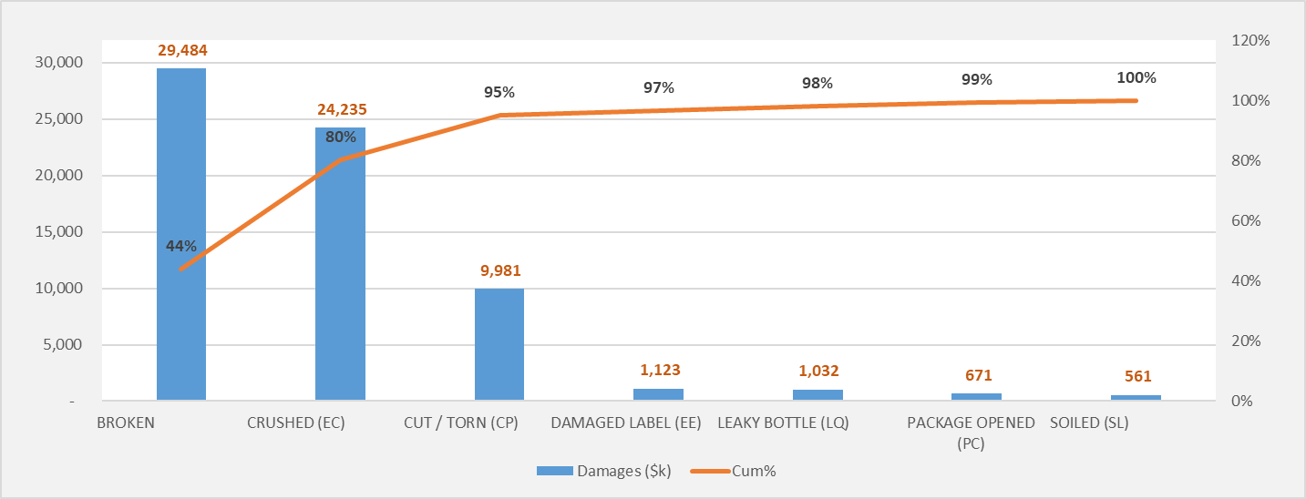
Pareto Example : Warehouse Damages
What Questions the Pareto Chart Answers
What are the largest issues facing the team or business?
What sources are causing 80 percent of the problems (80/20 Rule)?
Where should we focus our efforts to achieve the greatest improvements?

