Slide 1
5s basic training

Slide 2
What Is 5S?
A process and method for creating and maintaining a safe, organized, clean, high-performance workplace
A conditioning discipline for continuous improvement
Creates a workplace that quickly identifies problems
It is everyone’s responsibility and everyone has a role in its success

Slide 3
Why Implement 5S?
Creates proper environment for standard work
Achieves higher product quality, less damages
Reduces costs
Improves customer delivery times
Helps identify waste in our processes
Reduces hassles in the workplace
Creates a safer work environment for all employees

Slide 4
What are the 5S’s
A process and method for creating and maintaining an organized, clean, high-performance workplace
1 – Sort (“Seiri”)
2 – Straighten (“Seiton”)
3 – Shine (“Seiso”)
4 – Standardize (“Seiketsu”)
5 – Sustain (“Shitsuke”)

Slide 5
Step 1 – Sort
“When in doubt, move it out.”

Slide 6
Sort
Do I need it?
How much do I need?
Do I need it every day? Sometimes? Never? or just in case?
Does it belong to someone else?
‘When in doubt, move it out.’

Slide 7
Step 2 – Straighten
For ease of use
“A place for everything, and everything in its place.”

Slide 8
Straighten
Where do I need it?
Is it easily accessible? Within reach?
How do I know if it is missing?
Would labels or shadow boxing help?
‘A place for everything and everything in it’s place.’

Slide 9
“Designate a Place for Everything”

Slide 10
Step 3 – Shine
"A clean workplace enhances quality, safety, and pride."

Slide 11
Shine
Clean all surfaces and work spaces thoroughly
Clean/maintenance any tools/machines that are in your work space
Who will maintain cleanliness?
‘If it doesn’t get dirty, it doesn’t need to be cleaned.’

Slide 12
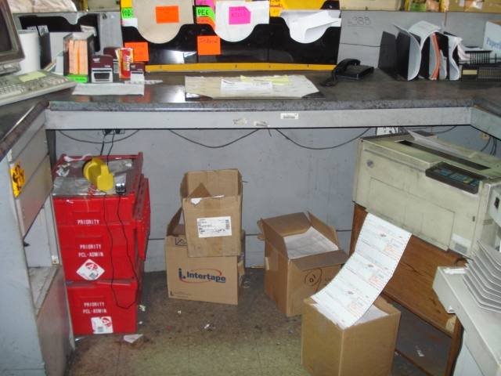
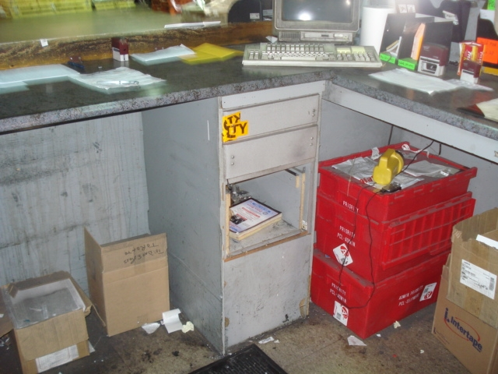
Dock Station – Before…

Slide 13
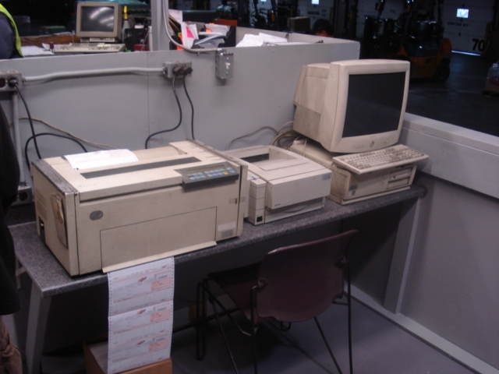
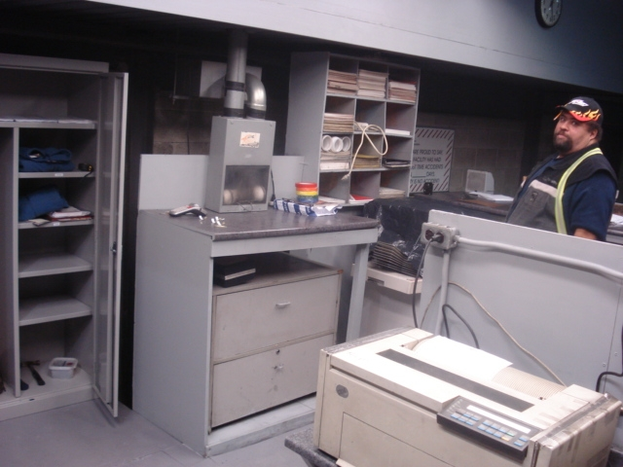
Dock Station – after…

Slide 14
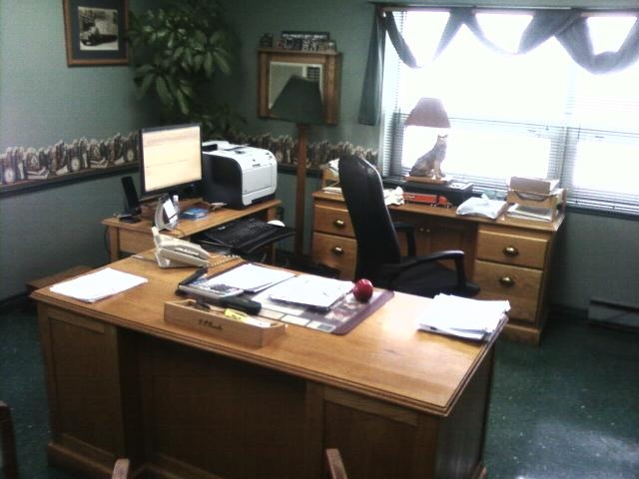
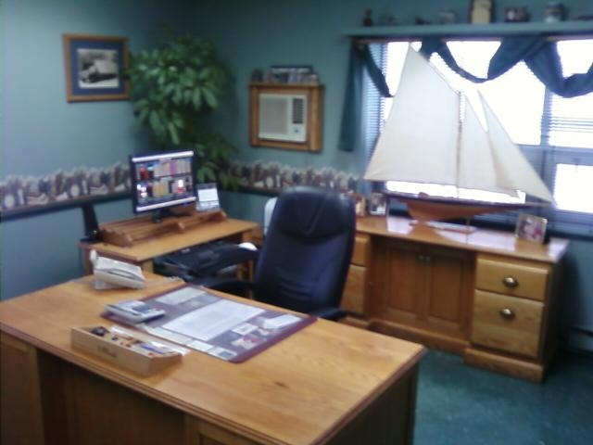
Office 5S

Slide 15
Standardize
What is the minimum requirement for the tools I need?
Are my tools in the right place? Any missing?
What do I need to do throughout the day and at the end of the day so my workspace is ready for me the next day?
How often do I need to clean/maintenance my tools?
How often will I audit or be audited?

Slide 16
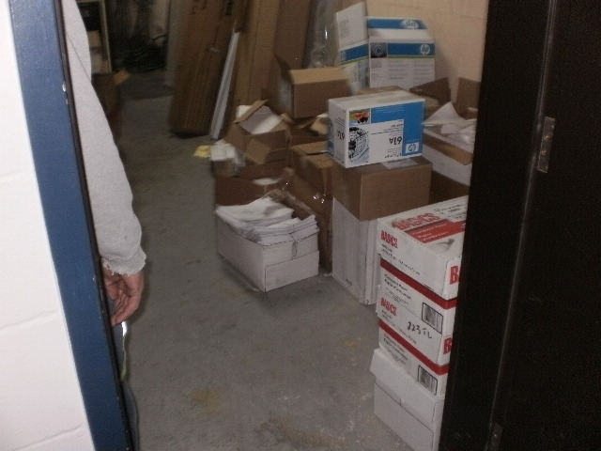
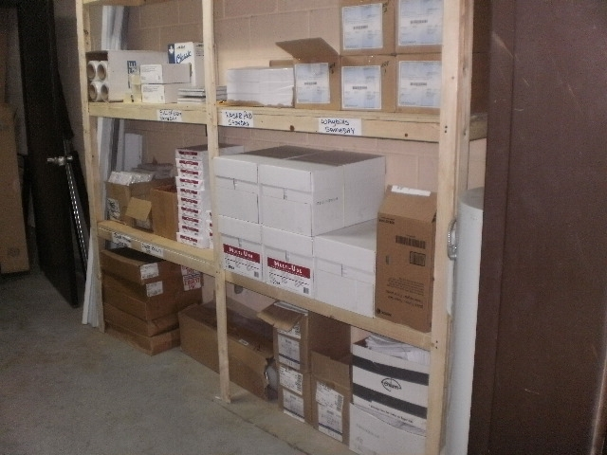
Storage Room

Slide 17
Step 5 – Motivate To Sustain
Leadership is key
Management at all levels must be committed
Supervisors must ensure that the shop floor meets 5S principles at the end of each day
Use standardized operations for monitoring adherence
Measure or audit to quantify results of workplace inspections
Prominently display each area’s results

Slide 19
Who Does 5S?
All functions and levels of employees should be involved in 5S
5S should not be attempted without participation from frontline staff
5S allows employees to focus on value-added activities

Slide 20
Benefits of 5S
For the Company
Improving Processes and Lowering Costs
Reducing Waste, fewer defects/damages
A good starting point for any Improvement Program
Safer place to work
For the Employees
A more pleasant Workplace
More Satisfying Jobs
Involvement in determining Workplace layout and Practises
Safer place to work

