Slide 1
Your yellow belt project storyboard template
A guide on how to create your project storyboard
David Pepin, knowledge transfer manager
Operational excellence

Slide 2
Storyboard: What’s Required
Yellow Belt Project Storyboard Template | Reference - Delete
Complete the Green Belt Storyboard Checklist (see following pages)
Tell Your Story Succinctly
  Use a maximum of 25 Slides (plus a title page) to describe your project
  Make sure the flow of the project story is logical
  Clearly illustrate your analysis and how solutions/countermeasures address the root causes
  Let visuals (graphs, charts, maps, pictures etc.) do most of the work
Use the Tools Wisely
  Show that you understand the DMAIC method by selecting the right tools for the right reasons during each Phase
  Add a “Key Take Away” to each slide to make it clear to the reader what you learned at each step
Label Your Graphs Clearly
  Title all graphs & charts, label each axis and indicate the time frame of the data and the axes names/units for each chart (along with the “Key Take Away”)
Be Clear About Your Analysis
  Describe all root cause hypotheses along with how you verified or disproved each one
Show Measureable Improvement
  Document each reduction in waste, time or defects and show "before" and "after” proof
See Yellow Belt Storyboard Checklist for Required Contents

Slide 3
Storyboard Checklist
Does not count toward total slide maximum
To replace with your own templates:
Use screenshots – or
Mac: Copy and paste “Special” with HTML format
PC: Copy and paste, select “Keep Source Formatting”

Slide 4
Storyboard Checklist (part 2)
Does not count toward total slide maximum

Slide 5
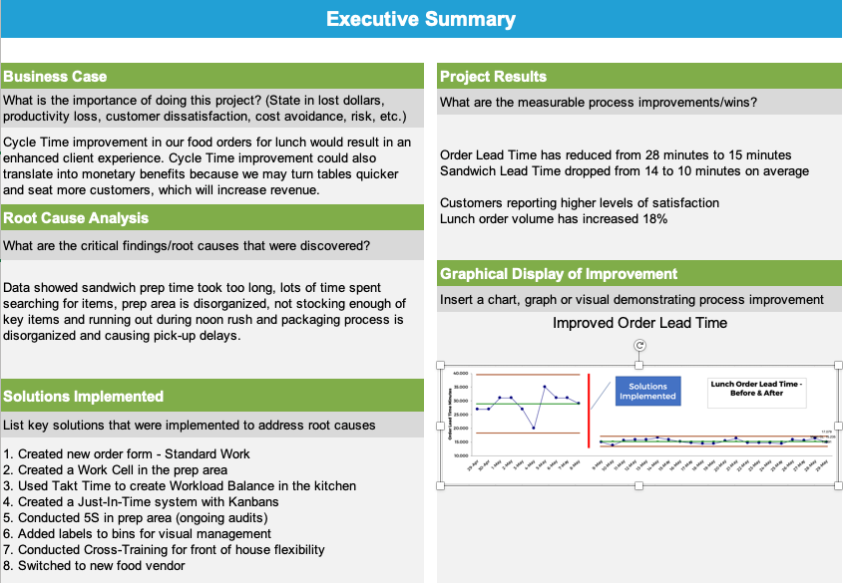
Executive Summary
Required
Key Take Away: The project was a great success! Profits are up, customers are happier and so is the Bahama Bistro staff!

Slide 6

Does not count toward total slide maximum
Define Phase

Slide 7
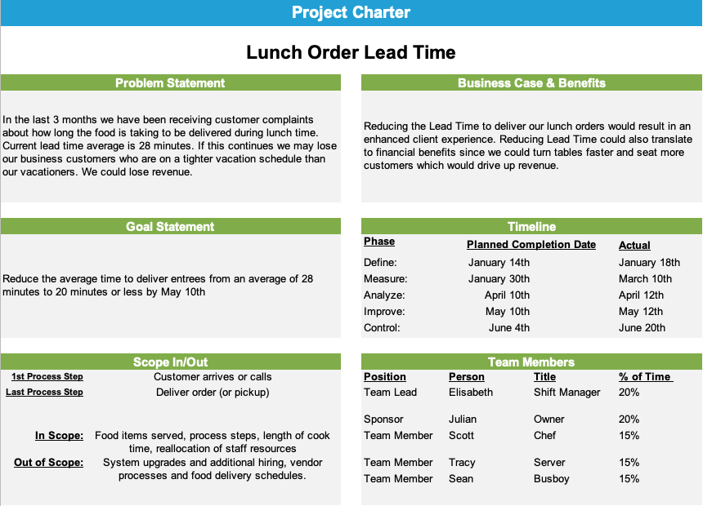
Project Charter
Required
Key Take Away: Excellent buy-in – project is worth doing.

Slide 8
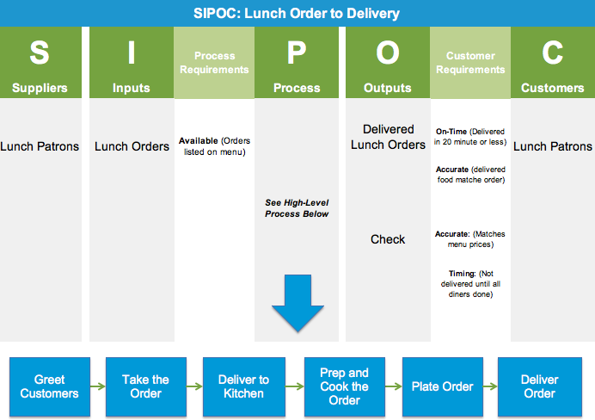
SIPOC
Required
Key Take Away: The scope of the project is from the moment we receive the customer order to the moment they receive their lunch order.

Slide 9
“As-Is” Detailed Map Segment
Required – Pick one or more detailed maps
Key Take Away: The team learned about the wait during the lunch order process walk – customers were not happy!

Slide 10

Does not count toward total slide maximum
Measure Phase

Slide 11
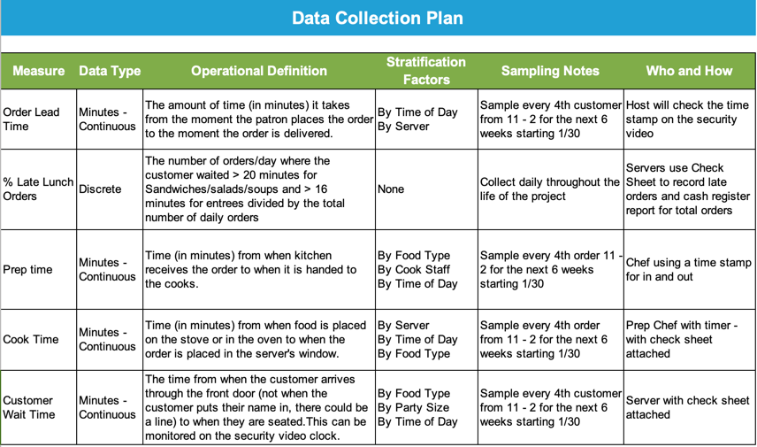
Data Collection Plan
Required
Key Take Away: This is a Lead Time project so, except for % late, most of the measures are continuous measures of process segment times.

Slide 12
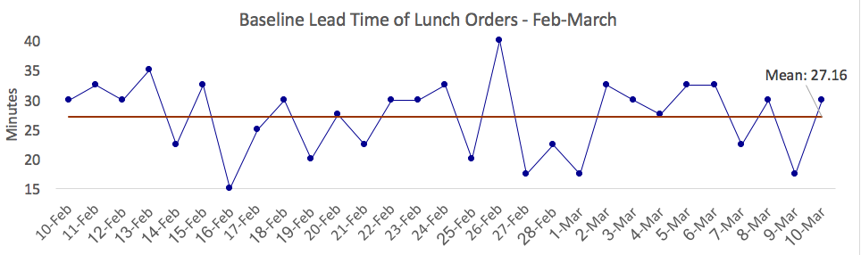
Baseline – Project Y
Required – Run Chart Display of Baseline
Key Take Away: Lots of variation in the process and the average time to serve lunch is 27 minutes which is very high!

Slide 13
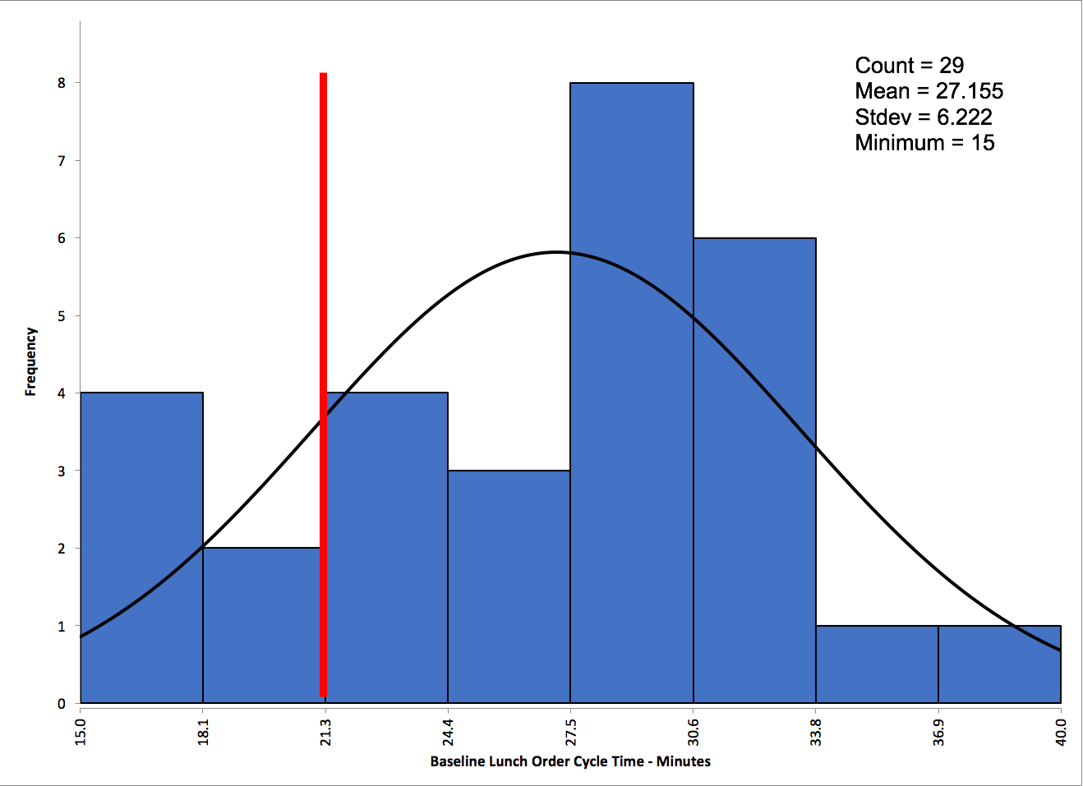
Baseline – Lunch Order Lead Time
Optional – Additional displays of baseline data
Key Take Away: Customers want delivery in 20 minutes or less, so the lunch delivery process is clearly not capable.

Slide 14

Does not count toward total slide maximum
Analyze Phase

Slide 15
Fishbone Diagram
Required
Key Take Away: The biggest areas to analyze further where prep time, sandwich area, packaging and server habits.

Slide 16
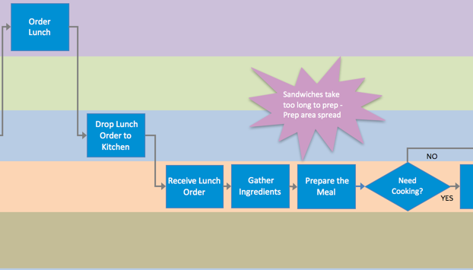
Map Segment Showing Analysis
Required – Insert one or more project-specific maps showing analysis
Key Take Away: Process analysis showed a potential for removing time wasted during packaging.

Slide 17
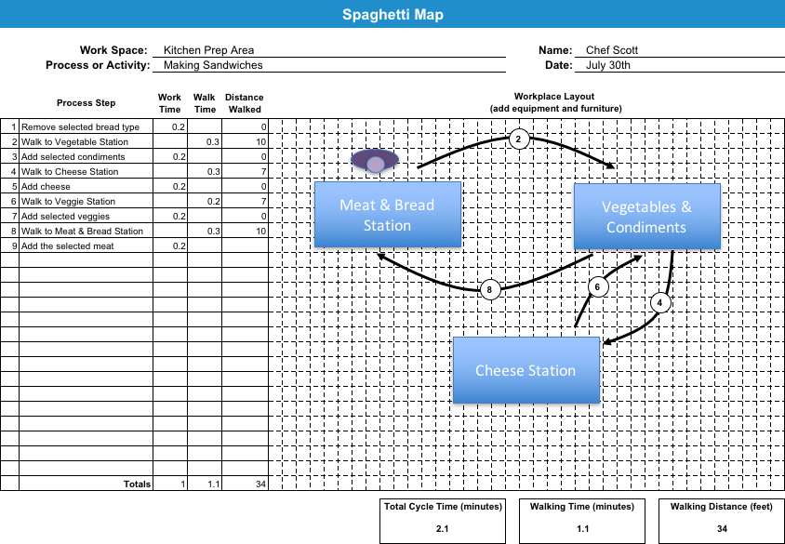
“As-Is” Detailed Map Segment
Optional – Add additional detailed map
Key Take Away: A 5S effort showed the waste of motion – the exercise included kitchen staff which resulted in increased employee engagement.

Slide 18
Map Segment Showing Analysis
Required – Insert one or more project-specific maps showing analysis
Value-Added Flow Analysis
Name: | Tracy | Process Name: | Lunch Order to Delivery
Date: | 10-Mar | Time Measured In: | Minutes | Hours | Days
 |  |  | (select units)
# | Process Step | Step Label (VA, NVA, NVAr) | Value Added Time | NVA & NVA-Required Work Time | NVA - Wait Time
 | Walk the customer order to the kitchen | NVA |  | 2
 | Check if it's readable | NVA |  | 2
 | If not readable, bring back to the waitress | NVA |  | 2
 | Ask the waitress to clarify the order | NVA |  | 2
 | Walk the customer order back to the kitchen | NVA |  | 2
 | Prep cook passes the order to the chef | NVA |  | 2
 | Chef assesses the order | NVA-r |  | 2
 | Ingredients assembled | VA | 2
 | Order cooked or prepared | VA | 7
 | Order plated | NVA-r |  | 1
 | Order placed on the warmer/staging | NVA |  |  | 1
 | Order waits for pickup | NVA |  |  | 10
 | Waitress picks up order | NVA |  |  | 2
 | Customer Receives the order | VA | 1
 |  | Time | % of total
Total Value-Added Work Time |  | 10 | 26.32% |  | 76
Total Non-Value-Added or NVA-r Work Time |  | 15 | 39.47%
NVA - Wait Time |  | 13 | 34.21%
Total Cycle Time |  | 38 | 100.00%
Key Take Away: Biggest opportunity to remove wait time is the pick-up area - there are also too many steps checking and clarifying the order.

Slide 19
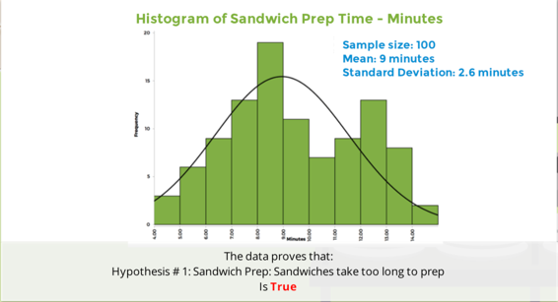
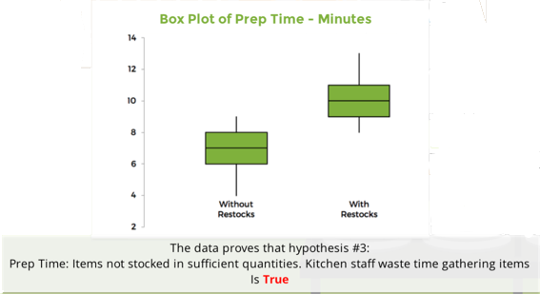
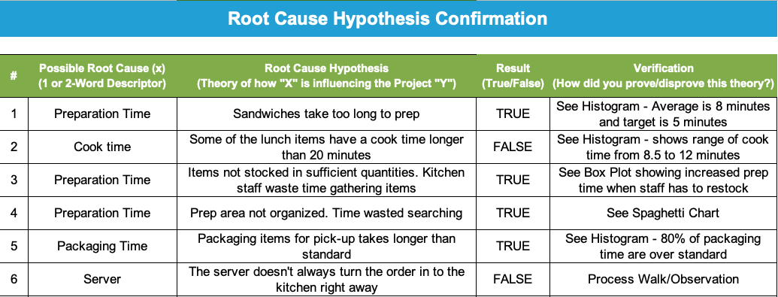
Root Cause Confirmations
Required
Key Take Away: Data confirmed most of the hypotheses except for cook time and server – neither contributed significantly to late lunch orders.

Slide 20

Does not count toward total slide maximum
Improve Phase

Slide 21
Selected Solutions
Required – Can also use Impact Effort Matrix
Solution Selection Matrix
Project Goal | Please rank each solution for each criteria by using the 1-5 Scale as indicated below
Enter Goal Statement below: (As stated on Project Charter)
Deliver lunch orders in less than 30 minutes by end of May | Very Low (less good) |  | Moderate |  | Very High (best)
 | 1 | 2 | 3 | 4 | 5
Potential Solution (Provide Brief Description) | Potential to Meet Goal | Positive Customer Impact | Cost to Implement (1 = $$$ & 5 = $) | Stakeholder Buy-in | Time to Implement (1 = Long 5 = Quick) | Total Score | Implement? Yes/No
Weighted Criteria | 10 | 9 | 8 | 7 | 5
Don't include condiments with takeout | 5 | 3 | 4 | 4 | 5 | 162 | Yes
Change vendors | 5 | 4 | 2 | 3 | 3 | 138 | Yes
Cross-Train servers and cashiers | 4 | 4 | 2 | 5 | 2 | 137 | Yes
Rebuild Take-out assembly space | 4 | 3 | 1 | 3 | 2 | 106 | Yes
Add new labled bins for condiments | 4 | 5 | 5 | 4 | 5 | 178 | Yes
Reduce the takeout menu | 3 | 3 | 3 | 3 | 2 | 112 | No
Key Take Away: There was no buy-in to reduce the take-out menu so the team focused first on cross-training which resulted in better staff relationships.

Slide 22
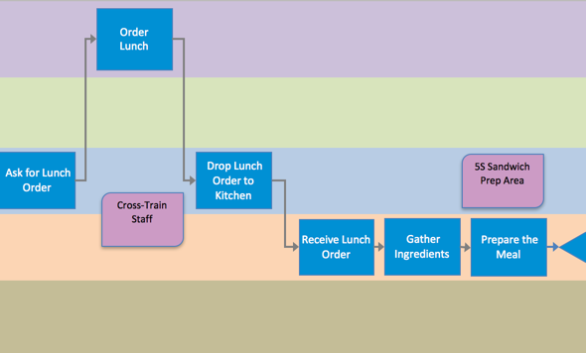
“To Be” Map Segment
Optional – Add Additional maps showing improvement
Key Take Away: Process changes including cross-training and 5Sing the Sandwich prep area made the difference.

Slide 23
“To Be” Map Segment
Required – Insert one or more project-specific maps showing improvement
Key Take Away: The “U” shape wastes the least amount of motion. Every item is within hands reach with the new setup.

Slide 24
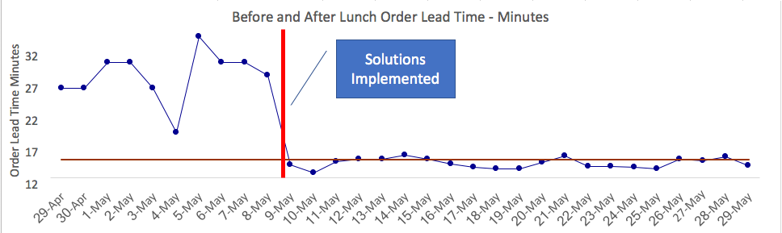
Run Chart Showing Improvement
Required – Run Chart showing before and after improvement
Key Take Away: Improvements had a big impact on lunch order Lead Time!

Slide 25

Does not count toward total slide maximum
Control Phase

Slide 26
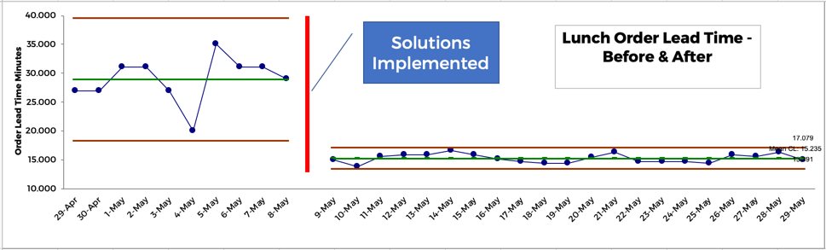
Control Chart Showing Improvement
Required – Control Chart showing before and after improvement
Key Take Away: Improvements had a big impact on lunch order Lead Time!

Slide 27
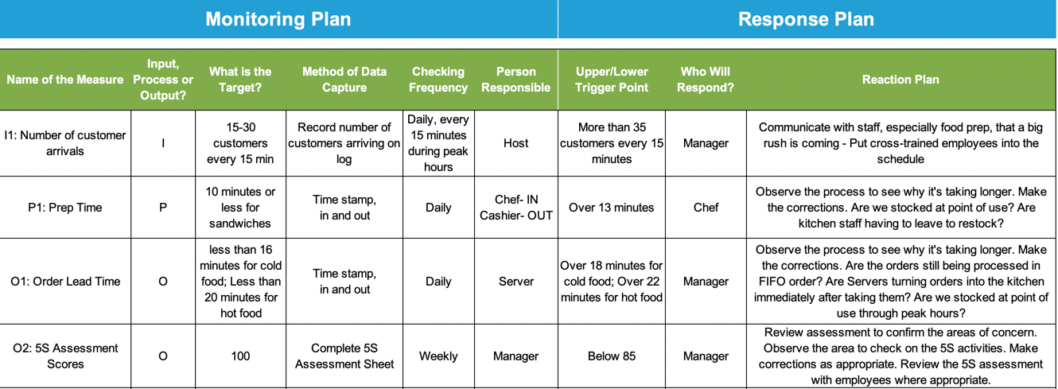
Monitoring & Response Plan
Required
Key Take Away: Good mix of an input and a process measure as predictors of the output measure, Lunch Order Lead Time, for ongoing monitoring

Slide 28
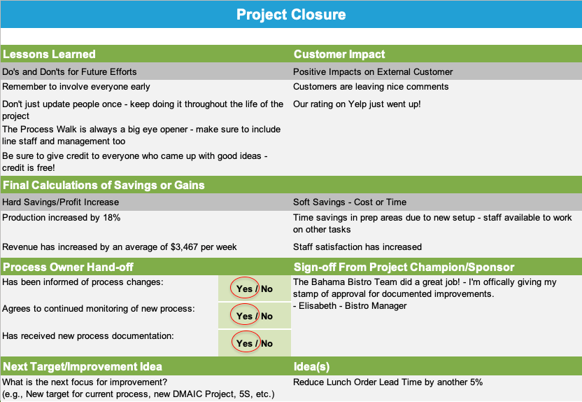
Project Closure
Required
Key Take Away: Ended up with some hard savings/increase in revenue and the Process Owner is thrilled. Ready for the next cycle of improvement!

Slide 29
Appendix
Does not count toward total slide maximum
Insert Key Words on first slide of Appendix
Include supporting documentation, process maps and data charts provide evidence of tool applications or helpful project background
Add the “Key Take Away” for each slide
Visit opex.ubc.ca for More Lean Six Sigma Resources!

Slide 30
Keywords (Specific to Your Industry)
Does not count toward total slide maximum
List all words and acronyms that are specific to your industry and key to understanding your project
Provide a brief description or definition of each term
List in alphabetical order
Keep in mind that this document will be viewed by those who are not in your industry or familiar with your process or industry

Slide 31
Keywords (Specific to Bahama Bistro)
Does not count toward total slide maximum
Order Lead Time: Total cycle time from the moment the customer places their order to the moment they receive their food.
Lunch Time: Key lunch ordering hours from 11am to 2pm
Customers: Business people and vacationers
Packaging Process: All tasks related to placing food into take-out containers, selecting utensils, napkins and condiments and then placing them all into a bag
Stock Items: All raw food items and food packaging items
Condiments: Mini-bottles of hot sauce, limes, salt and pepper

